Slide 1
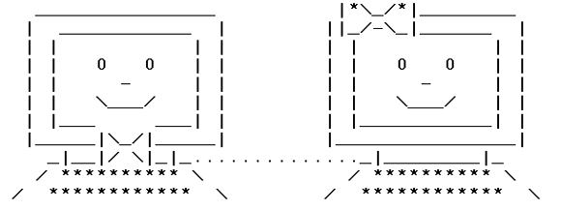
Bits and bytes

Slide 2
Way do we care?
Computers communicate with bits and bytes.
The Bitcoin network is just a network of computers that talks with each other.
Being able to read and understand these messages will greatly increase our understanding of the protocol.

Slide 3
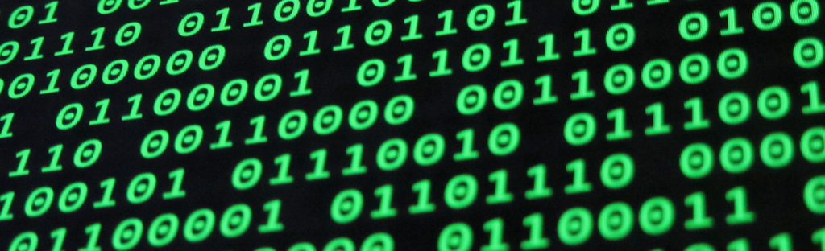
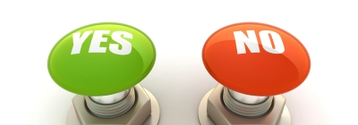
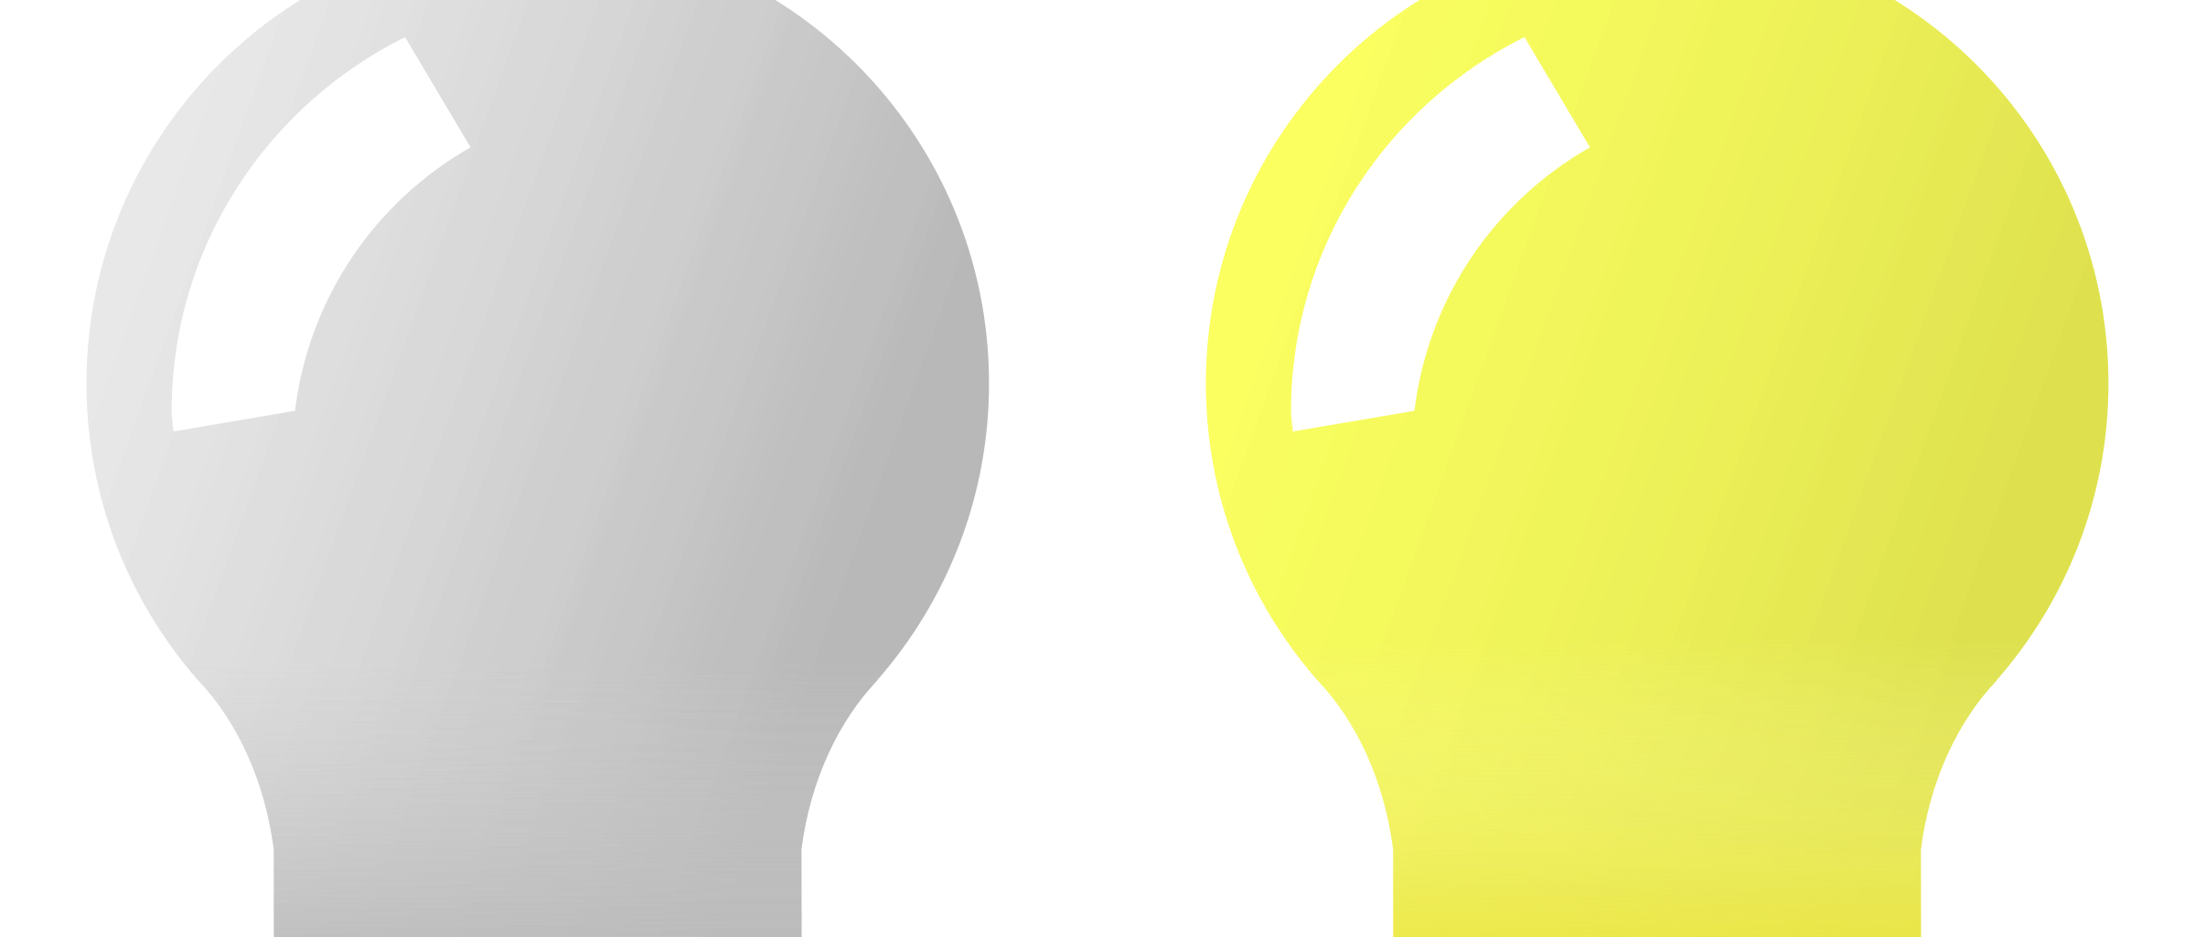
Binary code is the simplest way to convey information.

Slide 4
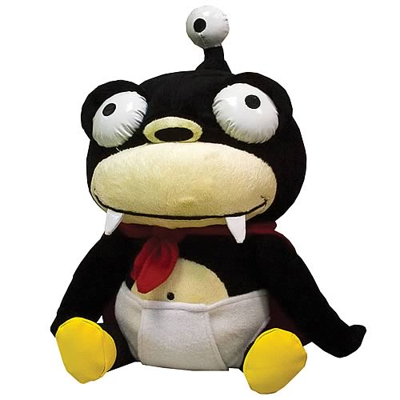
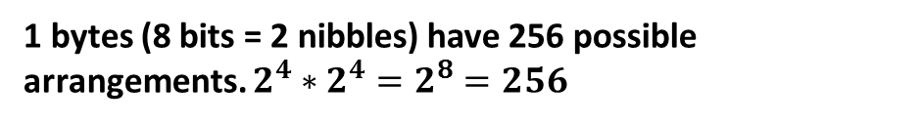
Bit is the most basic unit of information in the computer.
One bit contains one binary state.
Since each bit have 2 possible states, each nibble (4 bits) have 2^4 (16) possible arrangements.
1
0
1
0
0
0
0
4 bits = 1 nibble
2 nibbles = 1 bytes
1 bytes = 8 bits
1/0 for binary state
One box
=
One bit
0
0
0
1
0
0
1
1
0
1
1
1
1
0
1
0
1
1
1
1
0
0
1
0
1
0
0
0
0
1
0
0
1
0
0
1
1
0
0
0
1
0
1
1
1
0
1
1
1
0
1
1
1 bytes (8 bits = 2 nibbles) have 256 possible arrangements. $2^{4}∗2^{4}=2^{8}=256$

Slide 5
0
1
Decimal notation
Base 10
0
Hexadecimal notation
Base 16
2
1
3
2
4
3
5
4
1
ONE
1
6
10 digits
5
1
2
TWELVE
c
7
6
16 digits
8
7
1
8
EIGHTEEN
1
2
9
8
a
9
2
8
TWENTY EIGHT
1
c
b
c
d
e
f
Notes:
Creating the numbers one twelve eighteen twenty eight

Slide 6
0
1
Hexadecimal notation
Base 16
2
3
4
1
0
1
1
5
ONE
1
6
Remember that one nibble have 16 possible arrangements. All possible 16 arrangements can be expressed using ONE Hexadecimal digit
All possible arrangement for 2 nibbles (1 byte) can be expressed using TWO Hexadecimal digits
TWELVE
c
7
16 digits
8
EIGHT TEEN
1
2
9
a
TWENTY EIGHT
1
c
b
c
d
e
f
Notes:
Creating the numbers 18 and 24

Slide 7
American Standard Code for Information Interchange
DEC | HEX | BIN | Symbol | Description
70 | 46 | 0100 0110 | F | Uppercase F
71 | 47 | 0100 0111 | G | Uppercase G
72 | 48 | 0100 1000 | H | Uppercase H
73 | 49 | 0100 1001 | I | Uppercase I
74 | 4A | 0100 1010 | J | Uppercase J
75 | 4B | 0100 1011 | K | Uppercase K
76 | 4C | 0100 1100 | L | Uppercase L
This is the ascii table.
Each hex code (two digits) represent 1 ascii character

Slide 8
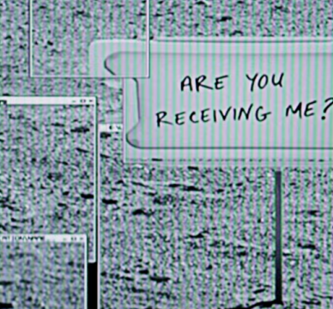
Remember this scene from “The Martian”?

Slide 9
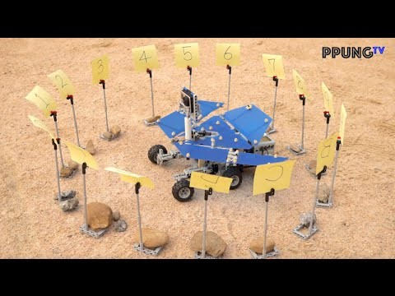

Slide 10
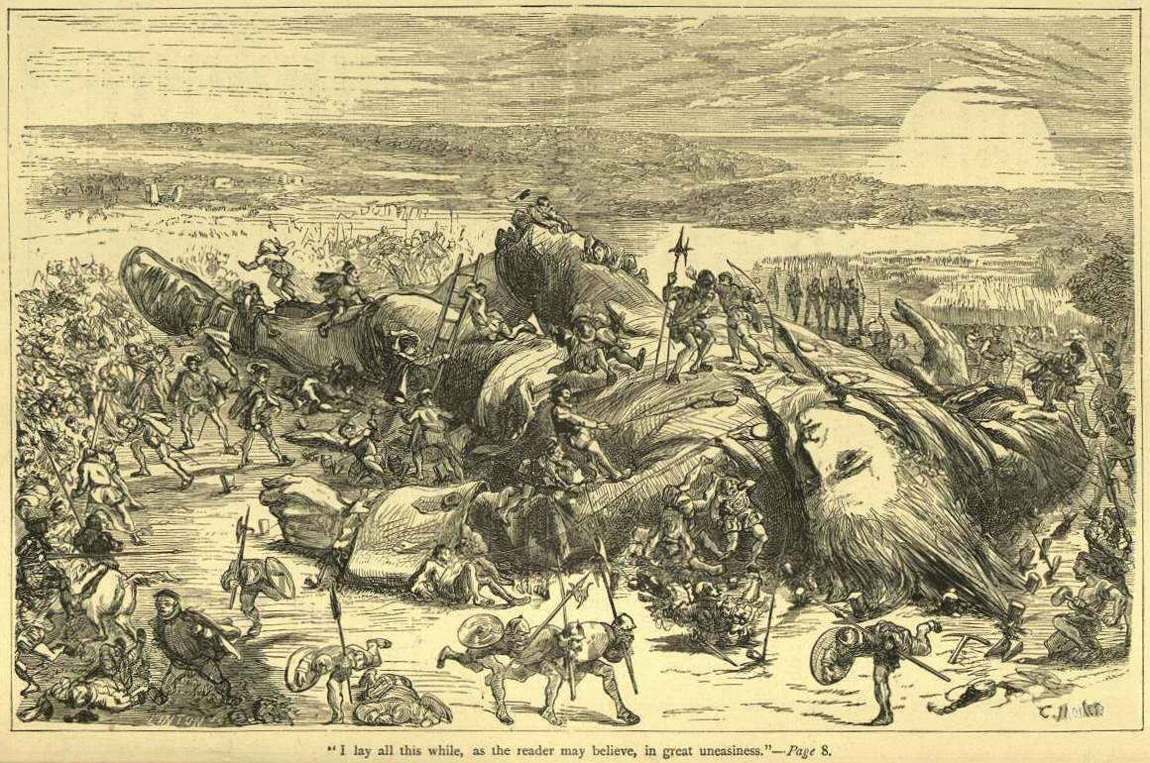
Little endian VS big endian
1a
c2
12
02
02
12
c2
1a
Notes:
Jonathan Swift's 1726 satire, Gulliver’s Travels

